Slide 1
Chapter 14: Protection

Slide 2
Chapter 14: Protection
Goals of Protection
Principles of Protection
Domain of Protection
Access Matrix
Implementation of Access Matrix
Access Control

Slide 3
Goals of Protection
Operating system consists of a collection of objects, hardware or software
Each object has a unique name and can be accessed through a well-defined set of operations
Protection problem - ensure that each object is accessed correctly and only by those processes that are allowed to do so

Slide 4
Principles of Protection
Guiding principle – principle of least privilege
  Programs, users and systems should be given just enough privileges to perform their tasks

Slide 5

Domain Structure
Access-right = <object-name, rights-set>
where rights-set is a subset of all valid operations that can be performed on the object.
Domain = set of access-rights

Slide 6
Access Matrix
View protection as a matrix (access matrix)
Rows represent domains
Columns represent objects
Access(i, j) is the set of operations that a process executing in Domain_{i} can invoke on Object_{j}

Slide 7

Access Matrix

Slide 8
Use of Access Matrix
If a process in Domain D_{i} tries to do “op” on object O_{j}, then “op” must be in the access matrix
Can be expanded to dynamic protection
  Operations to add, delete access rights
  Special access rights:
    owner of O_{i}
    copy op from O_{i} to O_{j}
    control – D_{i} can modify D_{j} access rights
    transfer – switch from domain D_{i} to D_{j}

Slide 9
Use of Access Matrix (Cont)
Access matrix design separates mechanism from policy
  Mechanism
    Operating system provides access-matrix + rules
    If ensures that the matrix is only manipulated by authorized agents and that rules are strictly enforced
  Policy
    User dictates policy
    Who can access what object and in what mode

Slide 10
Implementation of Access Matrix
Each column = Access-control list for one object
Defines who can perform what operation.
Domain 1 = Read, Write
Domain 2 = Read
Domain 3 = Read

Each Row = Capability List (like a key)
For each domain, what operations allowed on what objects.
      Object 1 – Read
      Object 4 – Read, Write, Execute
      Object 5 – Read, Write, Delete, Copy

Slide 11
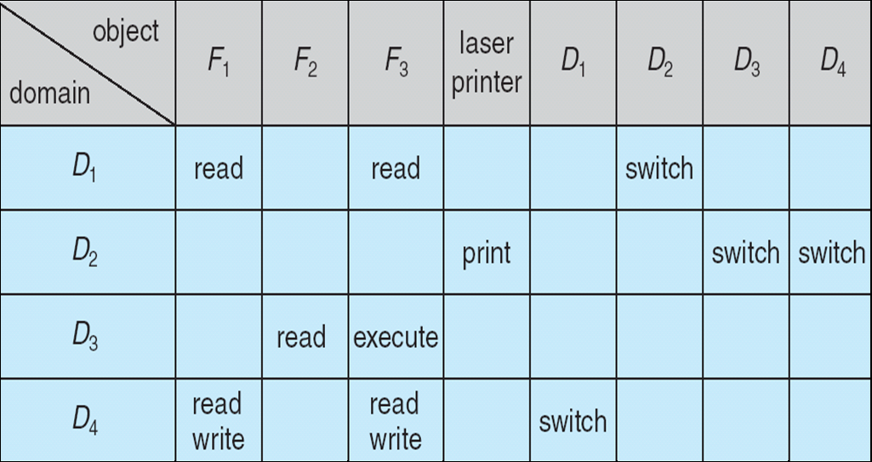
Access Matrix of Figure A With Domains as Objects
Figure B

Slide 12

Access Matrix with Copy Rights

Slide 13
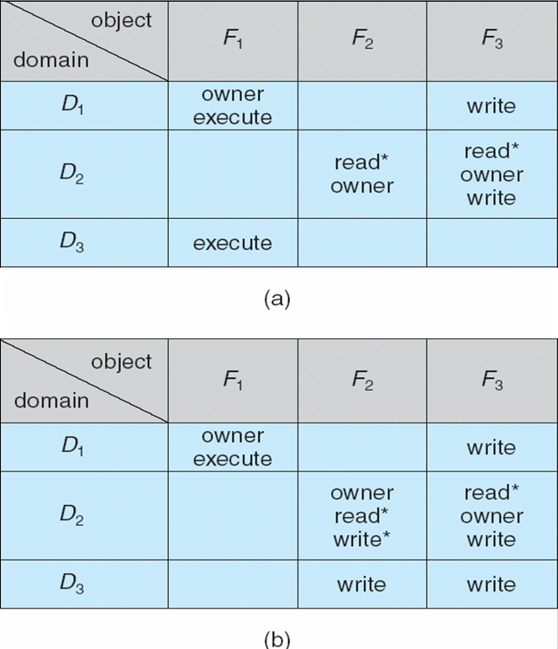
Access Matrix With Owner Rights

Slide 14

Modified Access Matrix of Figure B

Slide 15
Chapter 15: Security

Slide 16
Chapter 15: Security
The Security Problem
Program Threats
System and Network Threats
Cryptography as a Security Tool
User Authentication
Implementing Security Defenses
Firewalling to Protect Systems and Networks
Computer-Security Classifications
An Example: Windows XP

Slide 17
Objectives
To discuss security threats and attacks
To explain the fundamentals of encryption, authentication, and hashing
To examine the uses of cryptography in computing
To describe the various countermeasures to security attacks

Slide 18
The Security Problem
Security must consider external environment of the system, and protect the system resources
Intruders (crackers) attempt to breach security
Threat is potential security violation
Attack is attempt to breach security
Attack can be accidental or malicious(mu’lishus)
Easier to protect against accidental than malicious misuse

Slide 19
Security Violations
Categories
  Breach of confidentiality
  Breach of integrity
  Breach of availability
  Theft of service
  Denial of service(attempt to make a computer resource unavailable to its intended users)
Methods
  Masquerading (breach authentication)
  Replay attack
    Message modification
  Man-in-the-middle attack
  Session hijacking

Slide 20
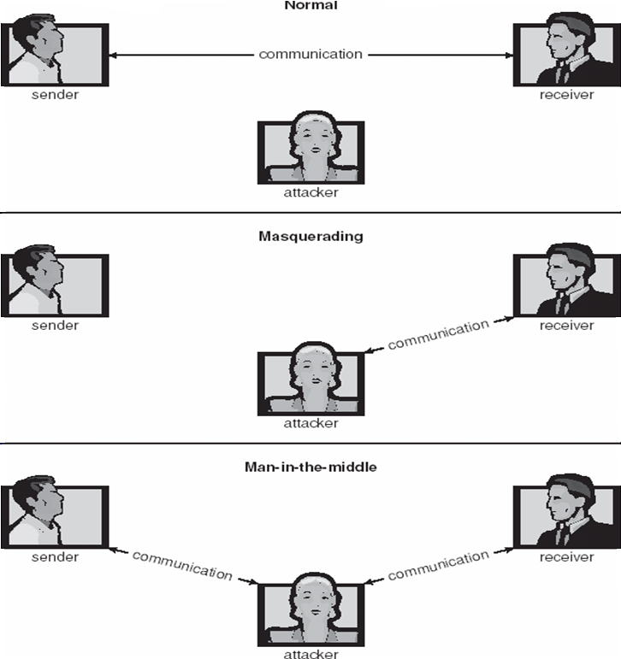
Standard Security Attacks

Slide 21
Security Measure Levels
Security must occur at four levels to be effective:
  Physical
  Human
    Avoid social engineering, phishing, dumpster diving
  Operating System
  Network
Security is as weak as the weakest link in the chain

Slide 22
Program Threats
Trojan Horse:Such program traps user login credentials and stores them to send to malicious user who can later on login to computer and can access system resources.
  Code segment that misuses its environment
  Exploits mechanisms for allowing programs written by users to be executed by other users
  Spyware, pop-up browser windows, covert channels
Trap Door:If a program which is designed to work as required, have a security hole in its code and perform illegal action without knowledge of user then it is called to have a trap door.
  Specific user identifier or password that circumvents normal security procedures
  Could be included in a compiler
Logic Bomb:Logic bomb is a situation when a program misbehaves only when certain conditions met otherwise it works as a genuine program. It is harder to detect.
  Program that initiates a security incident under certain circumstances
Virus − Virus as name suggest can replicate themselves on computer system. They are highly dangerous and can modify/delete user files, crash systems. A virus is generally a small code embedded in a program. As user accesses the program, the virus starts getting embedded in other files/ programs and can make system unusable for user

Slide 23
Program Threats (Cont.)
Many categories of viruses, literally many thousands of viruses
  File
  Boot
  Macro
  Source code
  Polymorphic
  Encrypted
  Stealth
  Tunneling
  Multipartite

Slide 24
System and Network Threats
Worms – use spawn mechanism; standalone program
Internet worm
  Exploited UNIX networking features (remote access) and bugs in finger and sendmail programs
  Grappling hook program uploaded main worm program
Port scanning
  Automated attempt to connect to a range of ports on one or a range of IP addresses
Denial of Service
  Overload the targeted computer preventing it from doing any useful work
  Distributed denial-of-service (DDOS) come from multiple sites at once
Notes:
finger is a program you can use to find information about computer users

Slide 25
System and Network Threats
Worms − Worm is a process which can choked down a system performance by using system resources to extreme levels. A Worm process generates its multiple copies where each copy uses system resources, prevents all other processes to get required resources. Worms processes can even shut down an entire network.
Port scanning-Port scanning is a mechanism or means by which a hacker can detects system vulnerabilities to make an attack on the system.
Denial of Service-Denial of service attacks normally prevents user to make legitimate use of the system. For example, a user may not be able to use internet if denial of service attacks browser's content settings.
Notes:
finger is a program you can use to find information about computer users

Slide 26
System and Network Threats
Worms – use spawn mechanism; standalone program
Internet worm
  Exploited UNIX networking features (remote access) and bugs in finger and sendmail programs
  Grappling hook program uploaded main worm program
Port scanning
  Automated attempt to connect to a range of ports on one or a range of IP addresses
Denial of Service
  Overload the targeted computer preventing it from doing any useful work
  Distributed denial-of-service (DDOS) come from multiple sites at once
Notes:
finger is a program you can use to find information about computer users

Slide 27

The Morris Internet Worm

Slide 28
End of Chapter 15

